Slide 1
Employee Data Analysis using Excel
STUDENT NAME : VENKADAKUMAR.R
REGISTER NO :122200616 (asunm131122200616)
DEPARTMENT : B.com (Corporate Secretaryship)
COLLEGE : St.Joseph ( Arts And Science )Collage Kovur.

Slide 2
PROJECT TITLE
Employee Performance Analysis

Slide 3


AGENDA
Problem Statement
Project Overview
End Users
Our Solution and Proposition
Dataset Description
Modelling Approach
Results and Discussion
Conclusion
3/21/2024 Annual Review

Slide 4

PROBLEM STATEMENT
The Statement Is About To Identify
Employee Salary
How Many Leaves They Have Taken
Individual Performance
Punctuality
Production Acheivement
Quality Percentage
Notes:
Employee

Slide 5

PROJECT OVERVIEW
The Project Overview Is About
If a company Is Under 5000 Employee
They have Calculating Monthly to Monthly Data
Of an 50000 employees Salary, Leave, Production Achievement ,Quality Percentage They Have taken Monthly to Monthly Report.

Slide 6




WHO ARE THE END USERS?

Slide 7

OUR SOLUTION AND ITS VALUE PROPOSITION
Conditional Formatting (missing)
Filter (Remove)
Formula (Performance)
Pivot (Summary)
Graph (Data Visuvalization

Slide 8
Dataset Description
Employee Id
Full Name
Gender
Date of Joining
Department
Start Date
Salary
FTE
Employee type
Work location
Production Acheviement
Quality Percentage

Slide 9

THE "WOW" IN OUR SOLUTION
*Performance level=IFS(Z8>=5,’’Very
HIGH’’Z8>=4,HIGH,Z8.=3,’’MED,’’TRUE,’’LOW’’)
3/21/2024 Annual Review
9

Slide 10
MODELLING
Data Collection
Excel Formatting
Chart
Pie Chart
Feature Collections
Google Logo
Data Bar
Performance Level
Accuracy Percentage
Algorithm
Excel
10

Slide 11
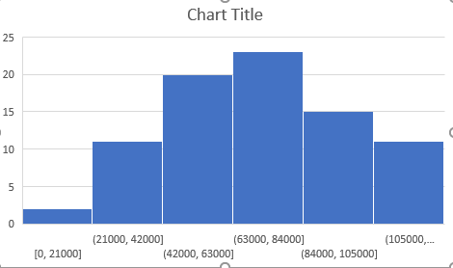
RESULTS
11

Slide 12
conclusion
The conclusion Is About
Employees Salary, Leave, Production Achievement ,Quality Percentage They Have taken Monthly to Monthly Report It Was An Use full Of Increment, Bonus Promotion These Are The Reason Are Used An Monthly to Monthly Report.

